Slide 1


BOTANIC MINDS
LEAVES AND PLANTS IDENTIFICATION
THROUGH IMAGE RECOGNITION

Slide 2
BOTANIC MINDS
Introduction
Plant Leaves Identification Using Image Recognition
Plant Leaf Identification Using Image Recognition is a computer vision project that classifies plant species based on leaf images. It analyzes unique leaf features like shape, texture, and color, with applications in botany, agriculture, and environmental conservation
Next

Slide 3
BOTANIC MINDS
Vision & Mission
Vision & Mission
01. VISION
To revolutionize plant identification by creating a user-friendly and accurate image recognition system that empowers individuals of all backgrounds to connect with the natural world and contribute to plant conservation
02. MISSION
Develop a cutting-edge plant identification application that leverages advanced computer vision techniques to provide reliable and accessible plant species identification.
Contribute to the conservation of endangered plant species by providing a rapid and efficient means of identification.
Create a sustainable and scalable solution that can be integrated into various platforms and devices.
Next

Slide 4




BOTANIC MINDS
Our Team
Meet Our Expert Team
Kunal Sood
(ksood315@gmail.com)
Lakshya Tomar
(lakshyatomar0110gmail.com)
Rohan Kardam
(rohankardam0@gmail.com)
Next

Slide 5
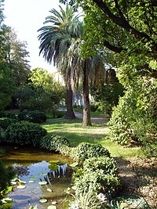
BOTANIC MINDS
Benifits
Objectives:
01
Biodiversity Conservation
Accurate plant identification aids botanists and ecologists in monitoring biodiversity, tracking endangered species, and implementing conservation strategies for vulnerable ecosystems.
03
Agriculture and Crop Management
Farmers and agronomists can use plant species recognition to monitor crops, detect invasive species, and improve crop management, enhancing yield and reducing losses.
02
Educational Tool:
The system acts as an interactive platform for botany students and researchers, helping them identify and study various plant species while fostering knowledge of plant biodiversity.
04
Rapid Field Research:
Field researchers can quickly identify plant species in remote areas, saving time and improving the accuracy of ecological surveys without relying on manual taxonomy.
Next

Slide 6
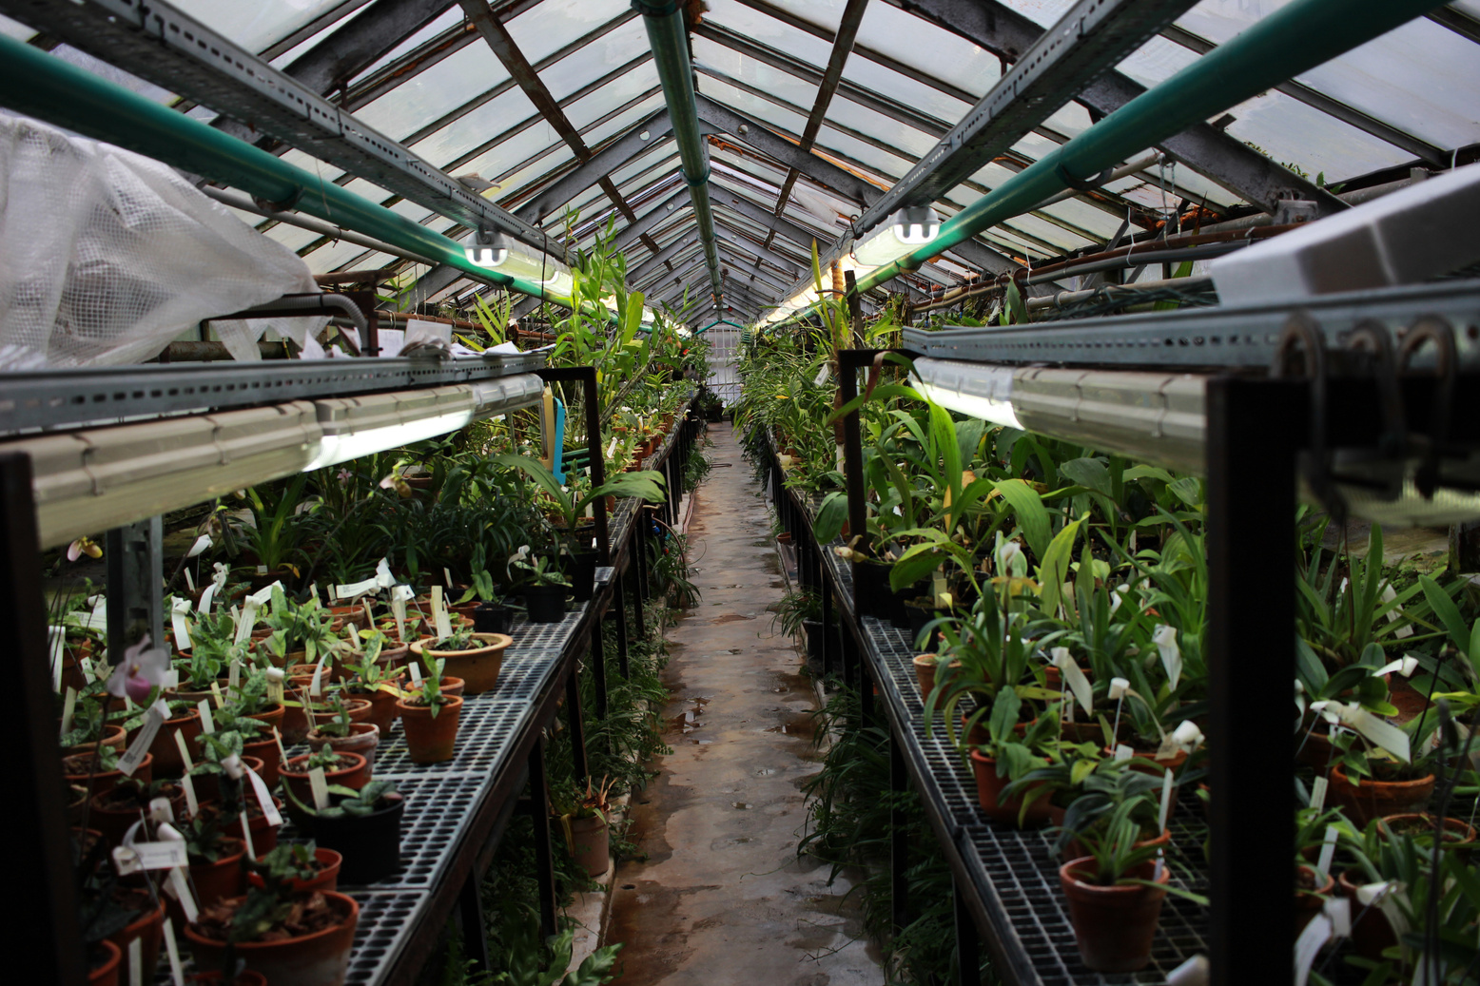

BOTANIC MINDS
Methodology
A Convolutional Neural Network (CNN) will extract key features from a labeled dataset of leaf images for species classification. Data augmentation techniques like rotations and flips enhance training diversity. The trained model is integrated into a web app, allowing users to upload leaf images via a drag-and-drop interface, providing real-time species predictions with confidence scores for accurate plant identification.
Methodology:
Next

Slide 7
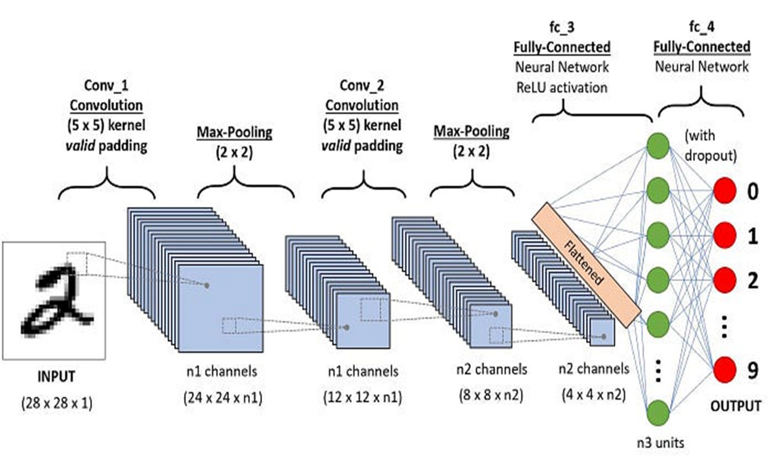
General CNN architecture
CNN Architecture: A Convolutional Neural Network (CNN) is used to learn and extract features from leaf images. The input images are resized to 128x128 pixels, and multiple Conv2D layers capture features like edges and textures. MaxPooling layers downsample feature maps, reducing complexity. A fully connected layer with 256 neurons, followed by a softmax output layer, classifies images into 4 leaf species. The model uses the Adam optimizer and categorical crossentropy loss function.
Your paragraph text
Your paragraph text
Your paragraph text

Slide 8

BOTANIC MINDS
Benifits
Why CNN:
01
High Accuracy in Plant Identification
Image recognition technology offers precise identification of plant species, minimizing errors compared to manual methods.
03
Scalability and Mass Identification
Image recognition can be scaled to process large amounts of data, identifying multiple plant species in real-time.
02
Time Efficiency
Automated image recognition drastically reduces the time required to identify and classify plant species.
04
Real-Time Monitoring and Decision Making
The ability to identify plant species instantly allows for real-time data analysis and decision-making.
Next

Slide 9

Limitations
Limited Dataset: Accuracy depends on the diversity of the training dataset; missing species or similar-looking species may be misclassified.
Environmental Variability: Changes in lighting, background, or image quality can affect species recognition accuracy.
Leaf Condition: Growth stages, damage, disease, or partial visibility of leaves may hinder accurate recognition.
Generalization: The model may struggle to recognize species outside of the training set.
Real-time Performance: Larger models or datasets may cause delays in image processing due to limited computational resources.
Dependence on High-Quality Images: Clear, well-lit images are needed for accuracy; poor-quality images reduce performance.

Slide 10

BOTANIC MINDS
Conclusion
Conclusion :
This project effectively implemented image recognition techniques for accurate plant species identification based on leaf characteristics. We achieved high accuracy in leaf identification, showcasing the potential of image recognition to revolutionize plant classification. The system offers real-time identification and instant feedback, benefiting agriculture, botany, and environmental conservation.
In conclusion, plant leaf identification using image recognition transforms our interaction with plant species, making the process faster, more accurate, and accessible.
Next

Slide 11
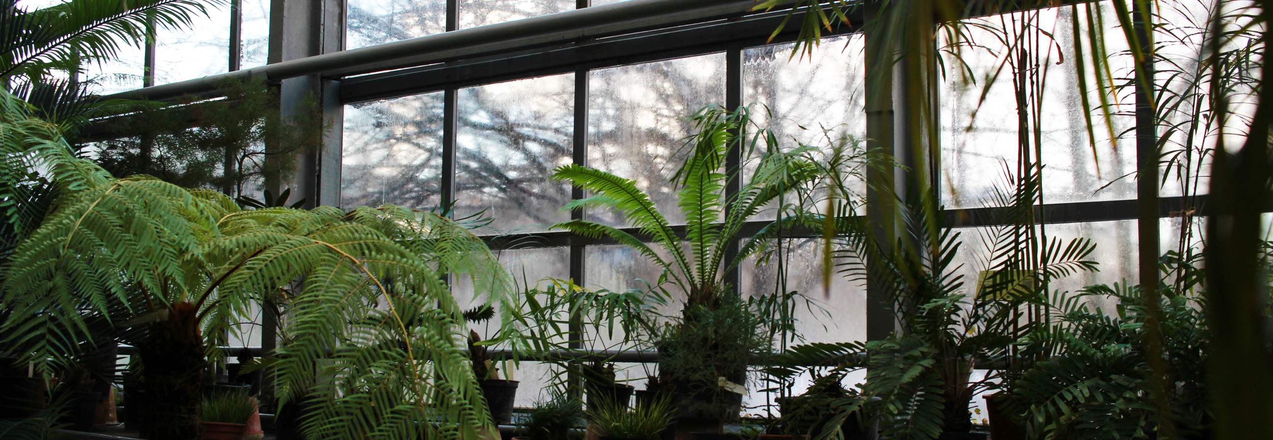
Thank You

